Slide 1
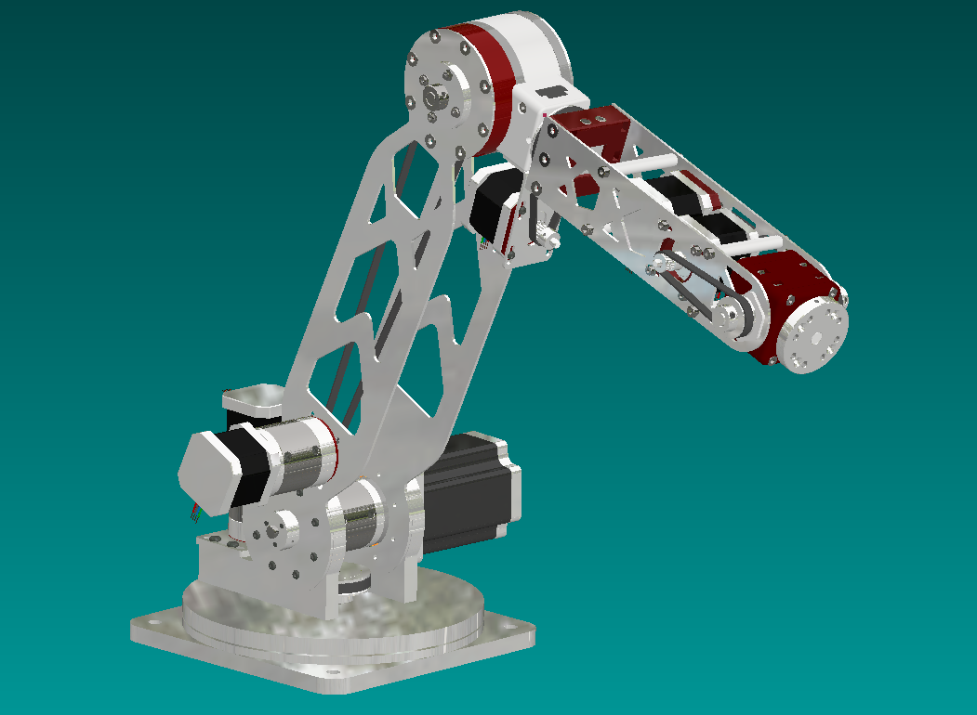
6 – Axis robot arm
Stefan, Sven & Thijs

Slide 2
Table of content
Designed control box
Explanation of all axis
End of arm tool
Parametric designed bearing
Planning for next week

Slide 3
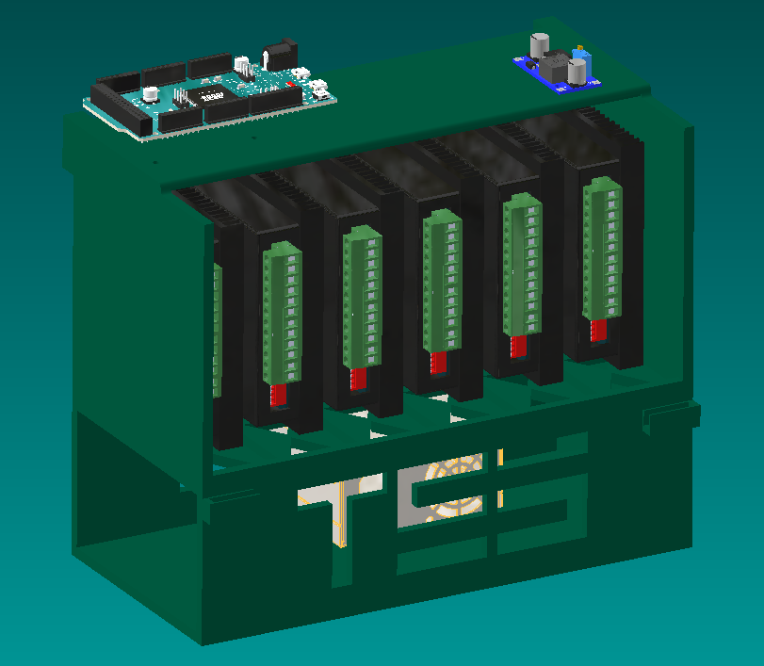
Control box
Stepper drivers and other components
Safety and heat reduction

Slide 4
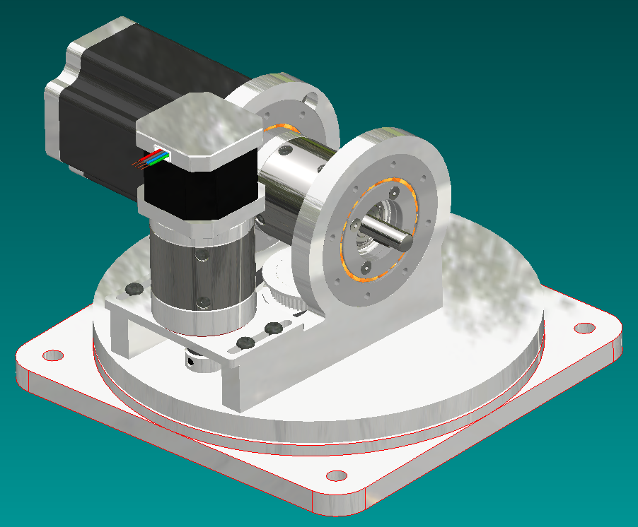
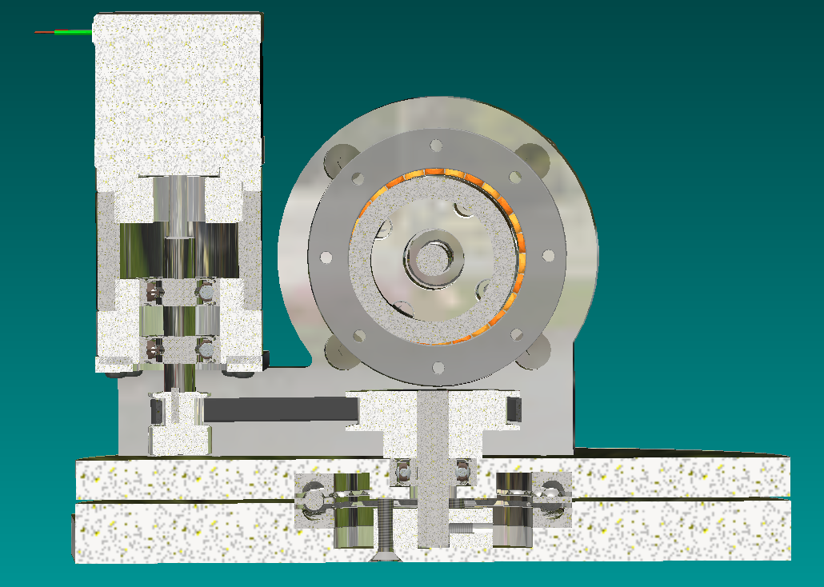
Axis 1
Axial bearing
Timing belt and pulleys
Stepper is rotating
with the second motor
Prevents two motors
from hitting each other

Slide 5
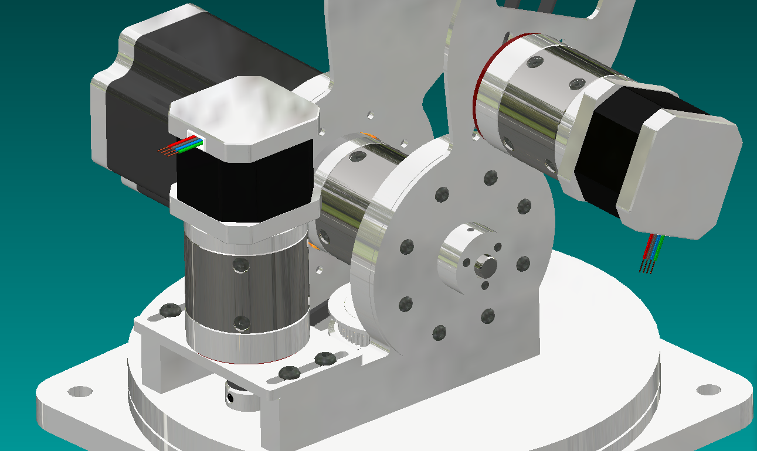
Axis 2
Larger stepper motor
Mounted via a
Planetary gearbox to the
First arm

Slide 6
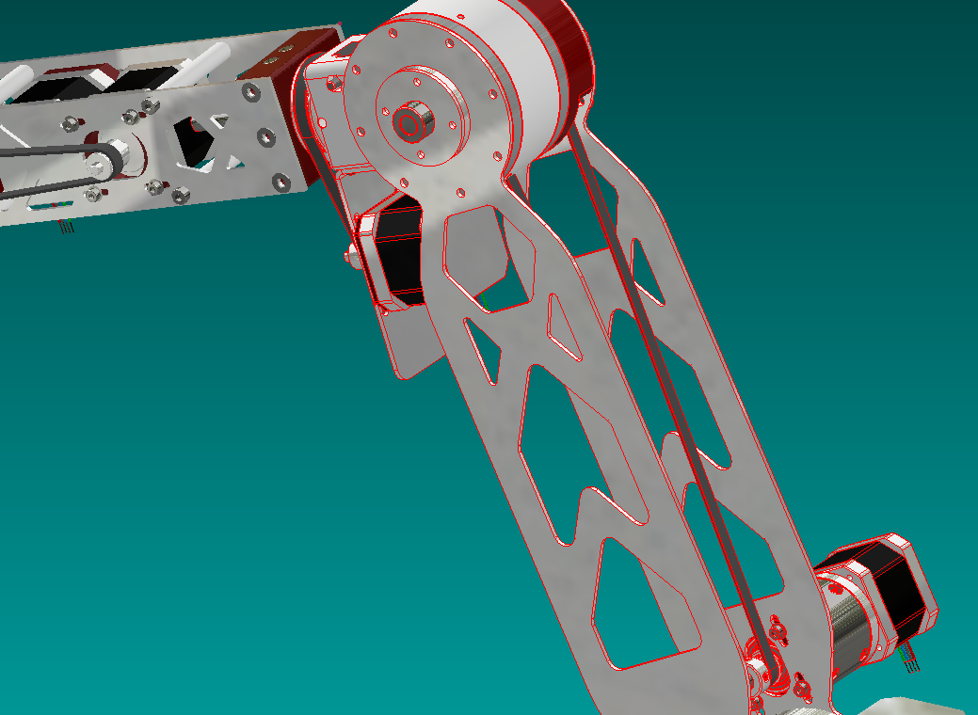
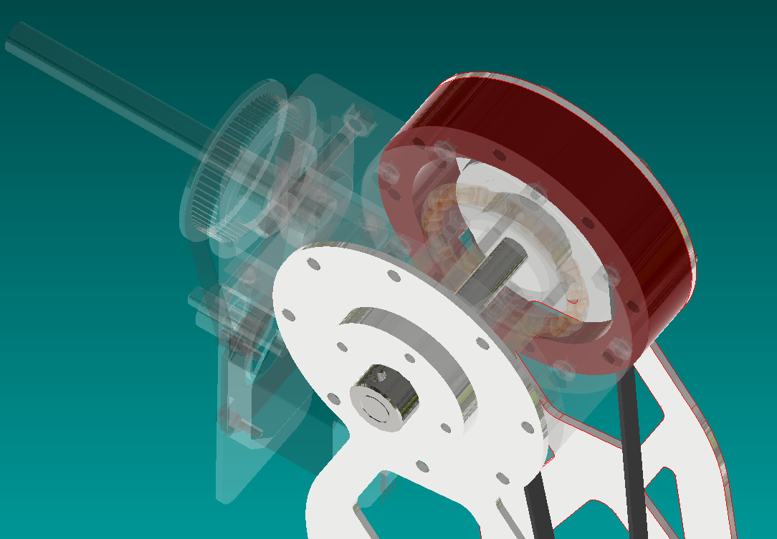
Axis 3
Stepper motor with
planetary gearbox
Timing belt with pulleys
Moves the second
arm

Slide 7
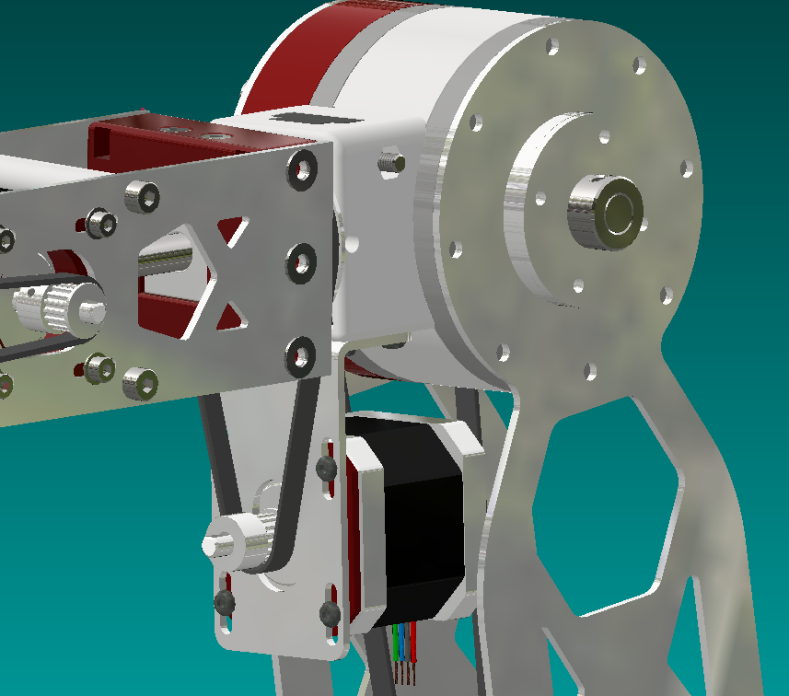
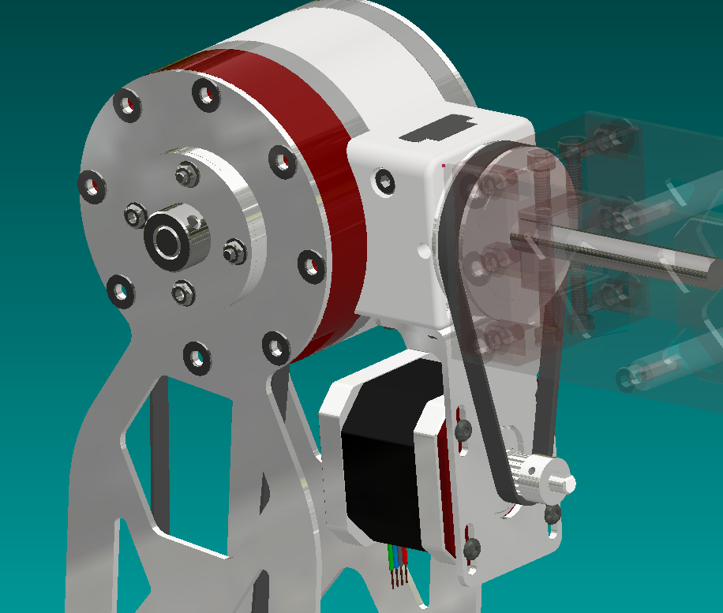
Axis 4
Stepper motor
Timing belt with pulleys
Rotates the second
arm

Slide 8
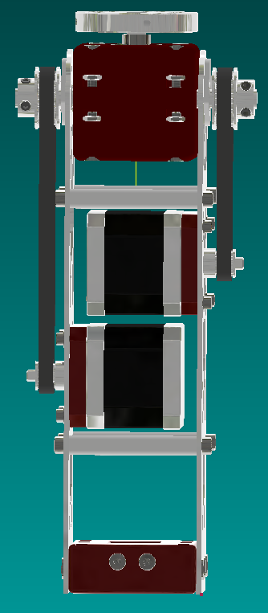
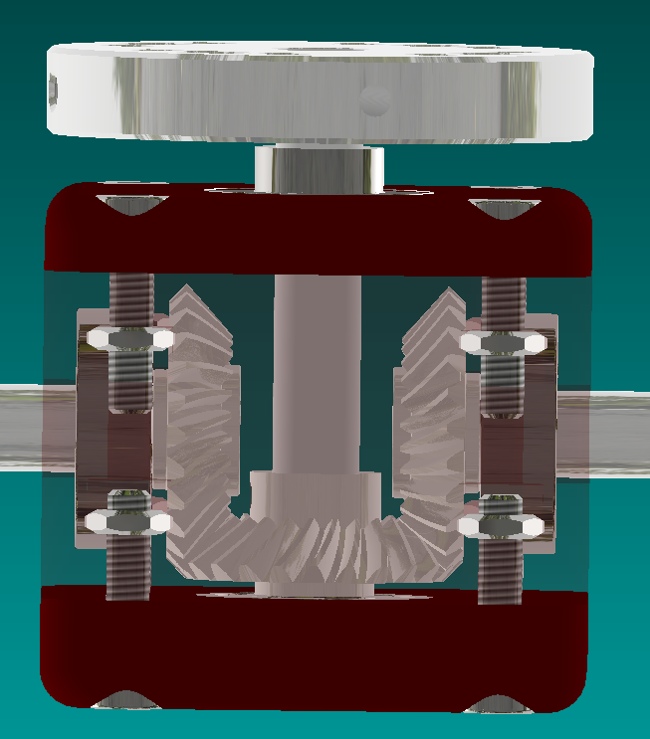
Axis 5 and 6
Two stepper motors
Timing belt with pulleys
Moves the differential gearbox
Bevel gears

Slide 9
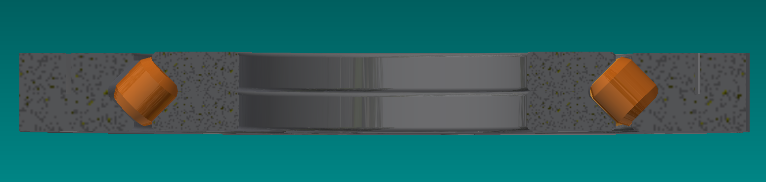
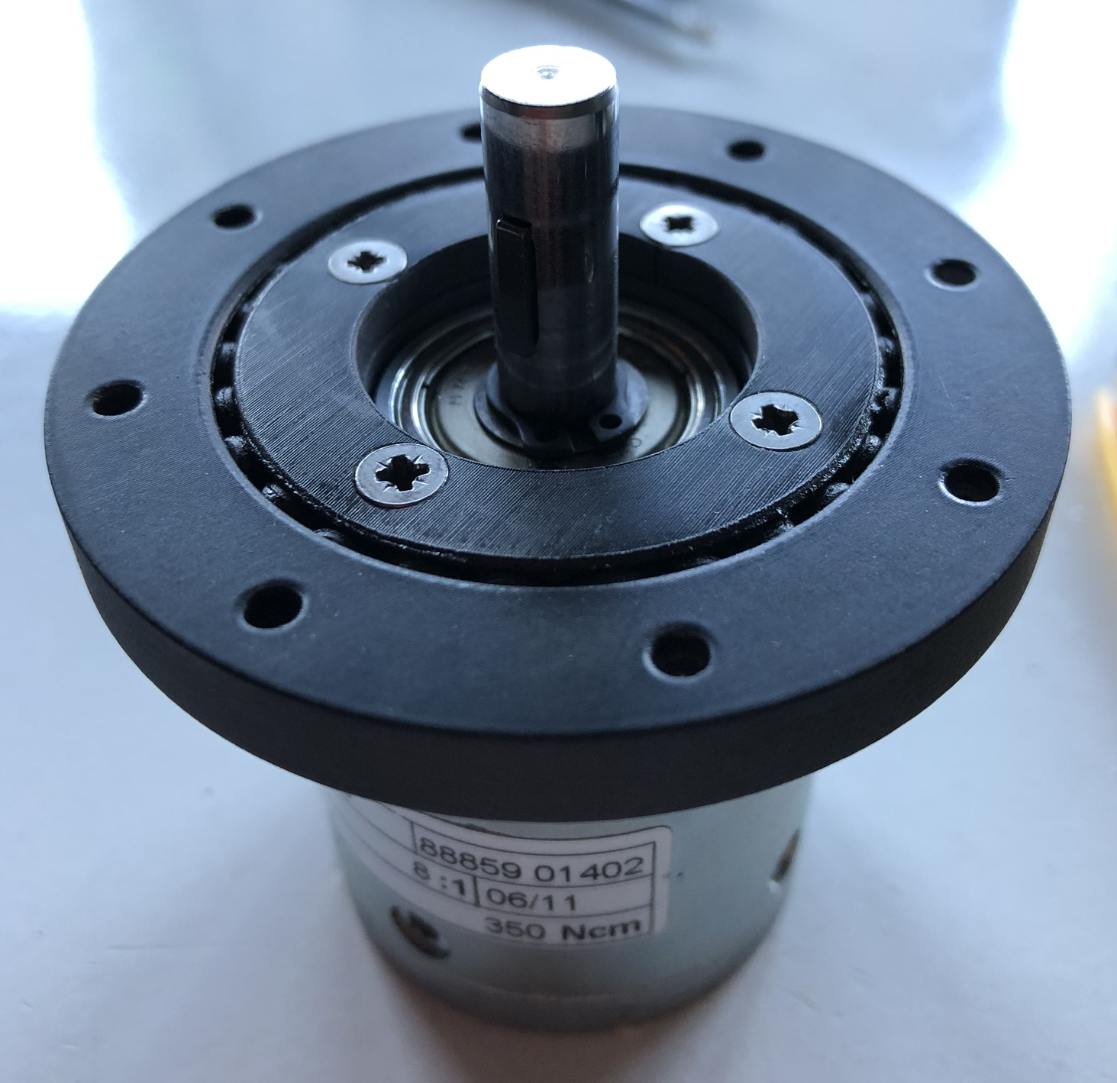
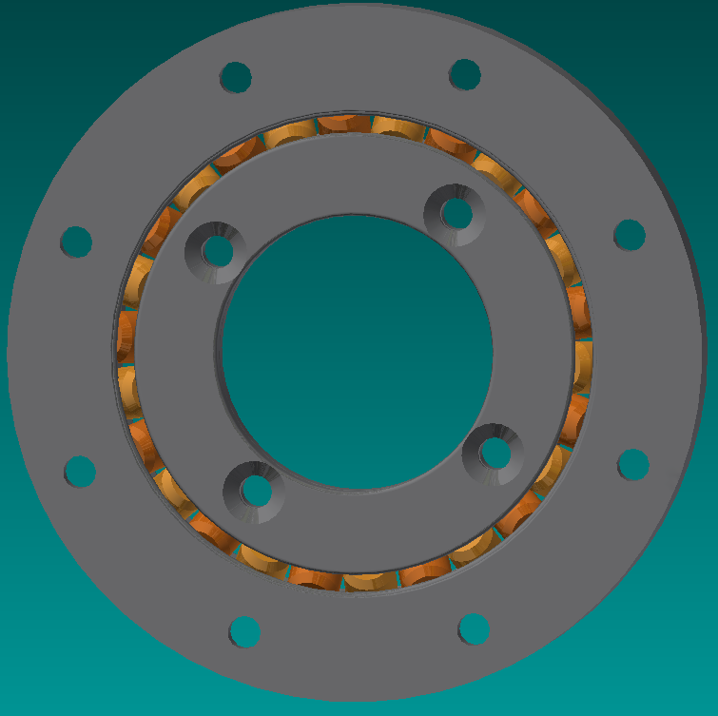
Parametric bearing design
Tutorial on YouTube
Search: “parametric 3D-printed bearing”
Uses rolls instead of balls
Adjustable

Slide 10
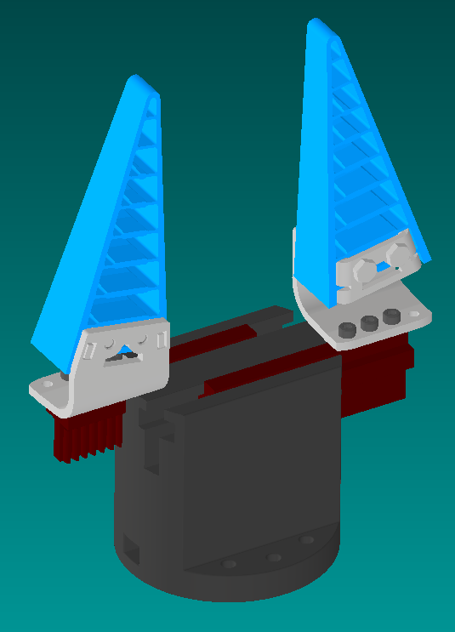
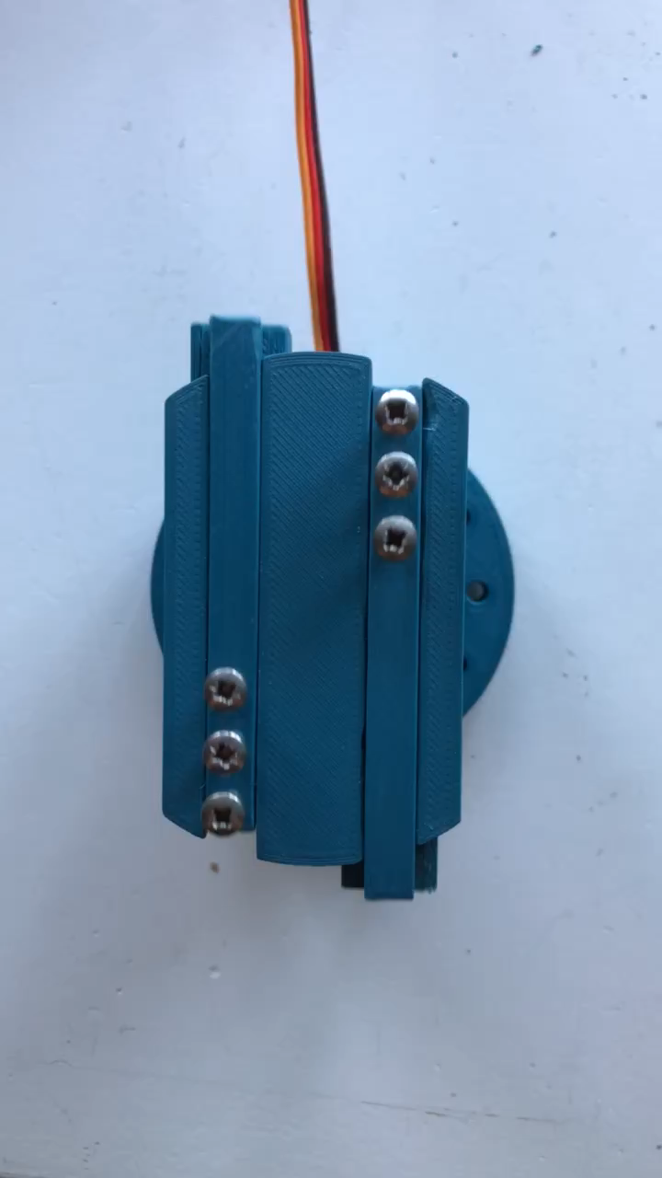
End of arm tool
Parallel gripper
Servo motor
Rack and pinion
Fits multiple grippers
Adjustable

Slide 11
Next week
Finish the design of the robot arm
Micro switches
Make / finish the design for the electronics box
Start making and programming the robot

Slide 12
Questions?

